Slide 1
REGISTRATION APPROVAL PROCESS AUTUMN SEMESTER (2019-20) (EXISTING STUDENTS)

Slide 2
ELIGIBLITY CRITERIA FOR REGISTRATION
STUDENT MUST BE ON INSTITUTE ROLL
PHYSICAL PRESENCE/ IN-ABSENTIA PERMISSION LETTER FROM DoAA
FEE PAYMENT EXCLUDING INTERNATIONAL STUDENTS
RESPONSE CODE GENERATED

Slide 3
DOCUMENTS REQUIRED
FOR DISPLAY (SOFT/HARD COPY):
IDENTITY CARD
PROOF OF FEE DEPOSITION i.e. RECEIPT/ TRANSACTION SLIP etc.
RESPONSE FORM CODE
FOR SUBMISSION (HARD COPY):
DOCUMENTS NOT DEPOSITED SO FAR, IF ANY
COPY OF AADHAR CARD

Slide 4
DATE SHEET
ONLINE PORTAL FOR FEE DEPOSITION ACTIVE W.E.F. JUL 05,2019
S. No. | REGISTRATION DATE(s) | FEE/ LATE FEE
1. | 16th JUL 2019 | No Late Fee
2. | 17th - 23rd JUL 2019 | Rs. 1000/-
3. | 24th JUL - 01st AUG 2019 | Rs. 1000/- With permission from DoAA

Slide 5
REGISTRATION APPROVAL PROCESS
LOG IN TO ACAD PORTAL
SELECT PROGRAM NAME & CLICK ON “GET CLASS LIST”
REGISTER OPTION ACTIVATED - ONLY IF FEE IS PAID & RESPONSE CODE GENERATED
IF DEACTIVATED – APPLICATION DULY RECOMMENDED BY CHAIRMAN, DAPC & HoD TO BE SUBMITTED TO DoAA FOR APPROVAL WITH LATE FEE (AS APPLICABLE)
16TH JUL 2019 ONWARDS- DATA WILL BE UPDATED EVERY HOUR

Slide 6
DON’Ts
DO NOT MENTION SUBJECT REQUEST/ ANY OTHER REQUEST ON PORTAL
DO NOT ADD ANY NAME MANUALLY IN HARD COPY OF REGISTRATION LIST
DISCREPANCY TO BE REPORTED TO ACADEMIC OFFICE
CONTACT DETAILS- 4866/ 4792/ dracademic@iitr.ac.in

Slide 7
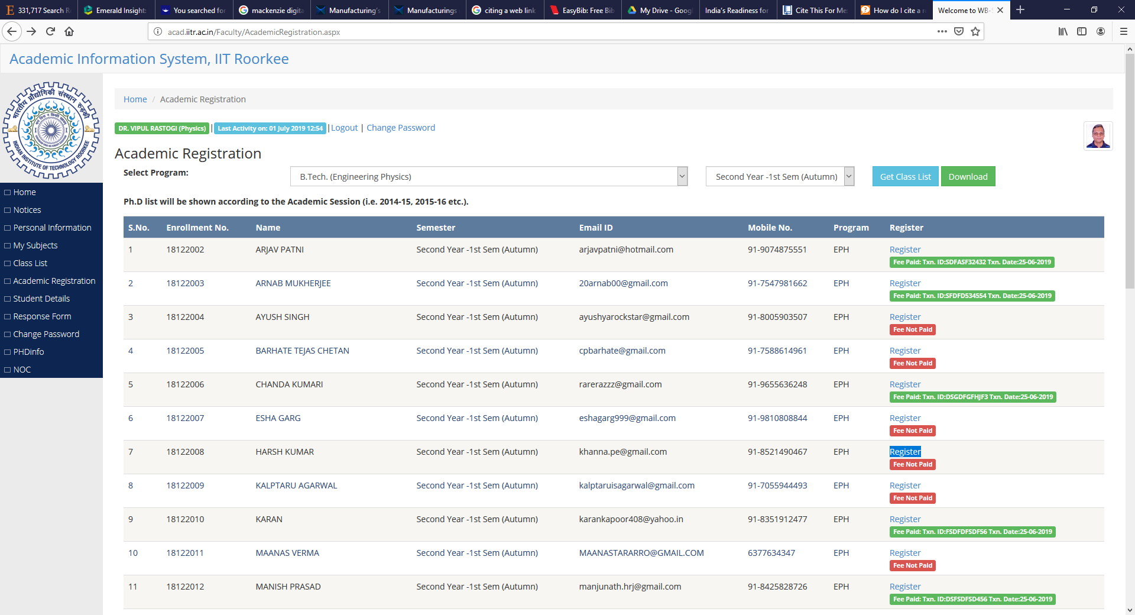
FEE DEPOSITION STATUS

Slide 8
RESPONSE CODE NOT GENERATED

Slide 9
Thanks…

